Slide 1
Rural Food Processing
18 September 2019
ME 476C - Team Cocoyam
Samantha Morrison - Project Manager
Nygel des Vignes - Financial Manager
Musab Al-Balool - Manufacturing Engineer
Humoud Alanjari - Logistics Manager

Slide 2
Outline of Presentation
18 September 2019
Project Description and Background
Benchmarking
Literature Review
Customer Requirements
Engineering Requirements
Schedule
Budget
Questions
Citations
Alanjari 2

Slide 3
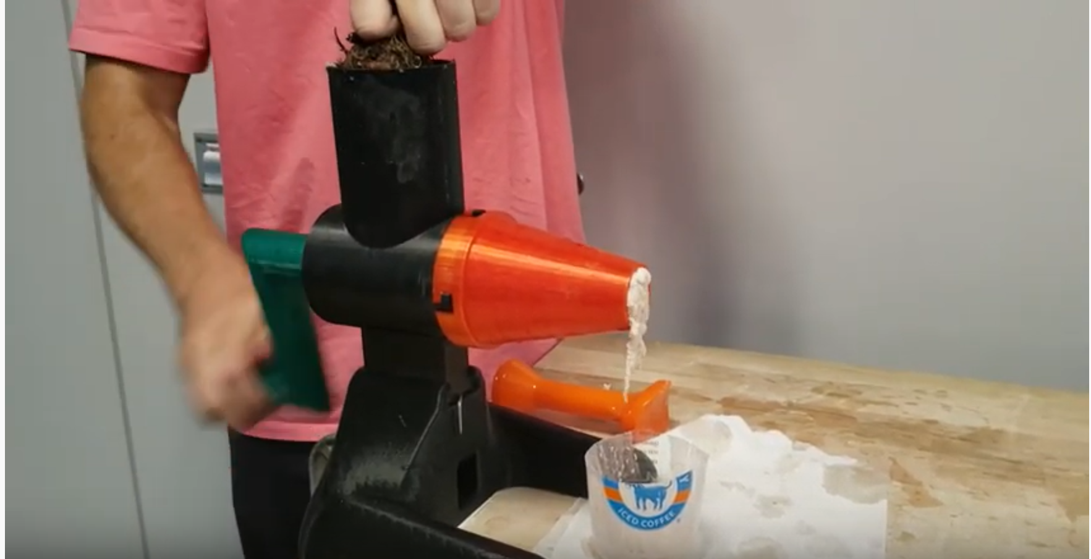
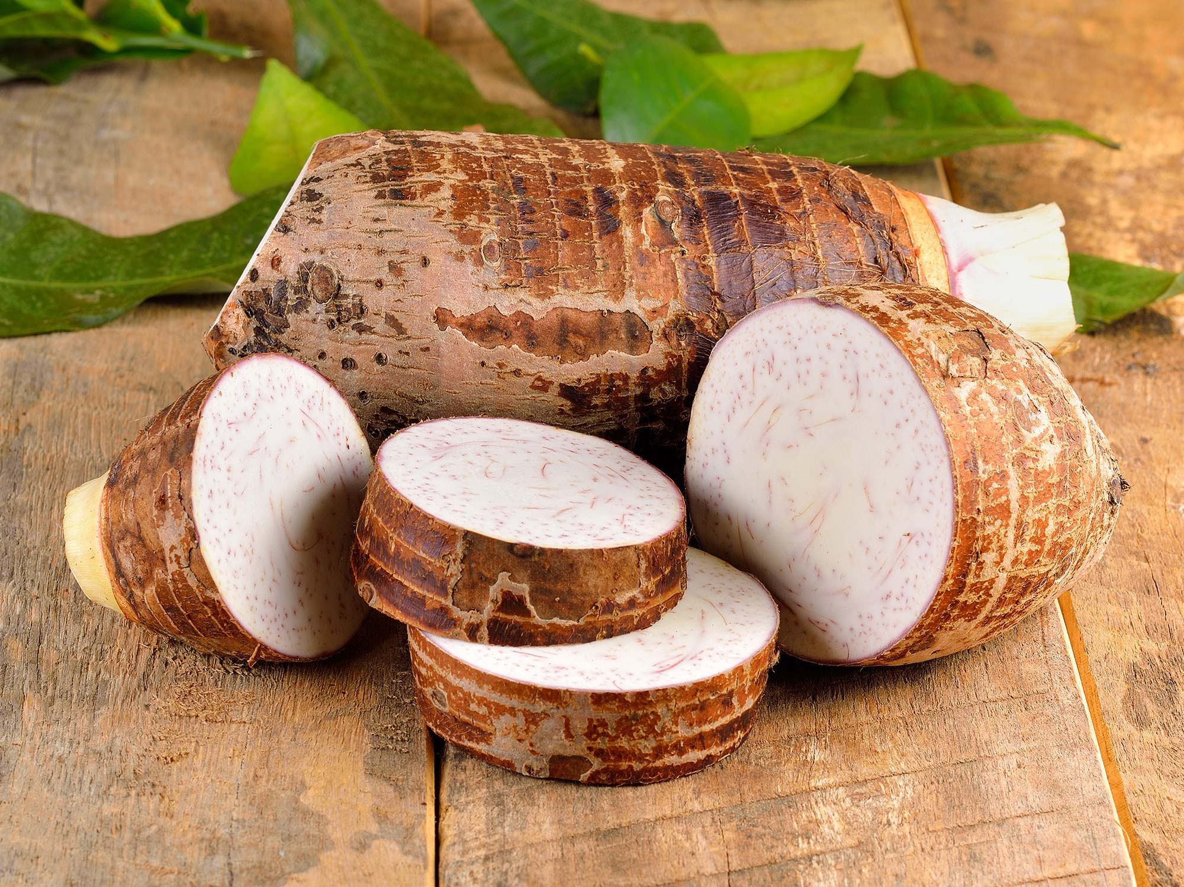
Project Description and Background
18 September 2019
Cocoyam dispenser and roller
  Continuation of Georgia Tech project
  Ekwang and Kwacoco Bible
Simple
Improve upon current hand rolling technique
Isaac Zama - Humanitarian
Sponsor - Gore
Help West and Central African Communities
Transfer of technology and knowledge
Figure 1: Manual grinder by Georgia Tech [1]
Figure 2: Raw Cocoyam [2]
Alanjari 3

Slide 4
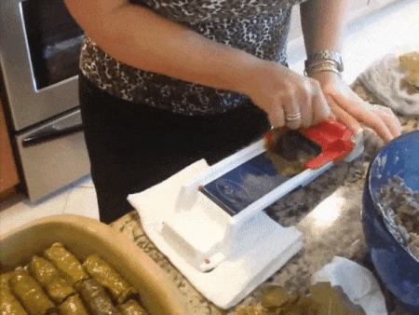
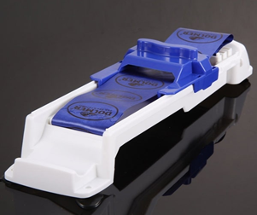
Benchmarking - Stuffed Grape Leaves Roller
18 September 2019
Advantage:
  Replaceable Parts
  2 Part Assembly
  Easy to Use
  Mechanical Roller
Disadvantage:
  Could Break Easily
  Replaceable part hard to find
Figure 3 : Rolling Process [3]
Figure 4 : Rolling Techniques [3]
Al-Balool 4

Slide 5
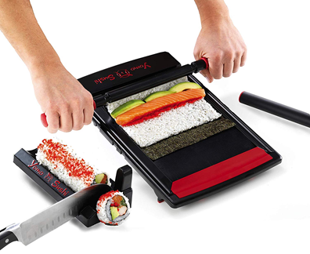
Benchmarking - Yomo Maker Kit
18 September 2019
Advantage:
  2 Easy step to roll
  1 piece board
  Durable
Disadvantage:
  Manual roller
  Takes time to assemble the process
Figure 5: Yomo Maker Kit [4]
Al-Balool 5

Slide 6
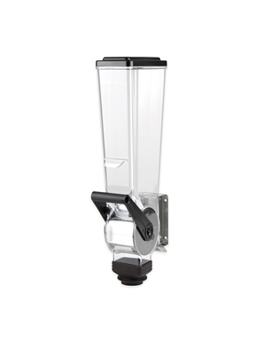
Benchmarking - Food Dispenser
18 September 2019
Advantage:
  Easy Refills
  Lever to dispense certain quantity
Disadvantage:
  One stage dispensing
  Small dispensing hole
Figure 6: Food Dispenser 2L [5]
Al-Balool 6

Slide 7
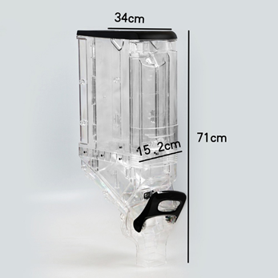
Benchmarking - Plastic Bulk Food Dispenser
18 September 2019
Advantage:
  Easy to refill
  Different stages of dispensing
  Hard to break
Disadvantage:
  Could not be fixed to a certain location
  Too large
Figure 7: Plastic Container Bulk Food Dispenser Mechanism [6]
Al-Balool 7

Slide 8
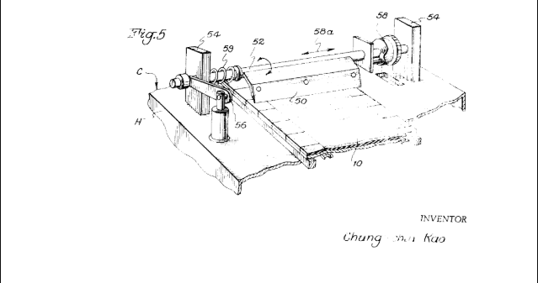
Literature Review - Rolling machine
18 September 2019
The machine is mounted on a horizontal stainless steel plate and three pads connect vertically.
These sets are connected to a belt.
The belt in the machine makes the process faster.
Using a rolling machine will definitely hit our goal with using a method faster than the hand rolling.
Figure 8: Rolling Machine Mechanism [7]
Al-Balool 8

Slide 9
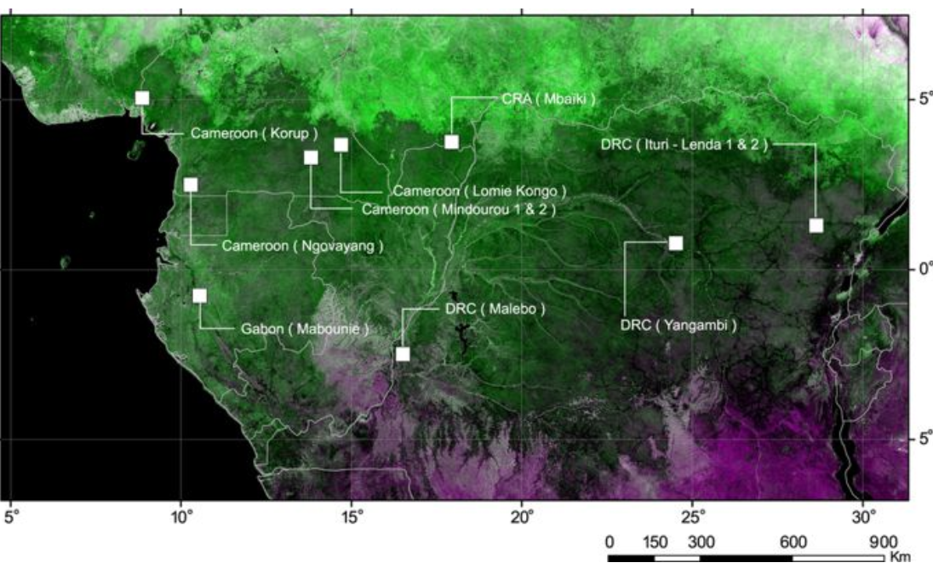
Literature Review - Resources in Central Africa
18 September 2019
“The forests of Central Africa constitute the second-largest continuous tropical forest in the world and, in contrast with other areas, still maintain high densities of large mammals” [8]
Forest natural resources
Eco-friendly
Figure 9: Image of forest in Central Africa [9]
Alanjari 9

Slide 10
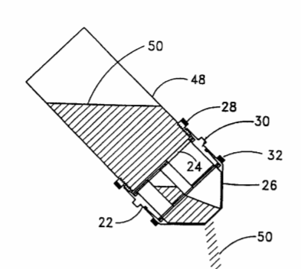
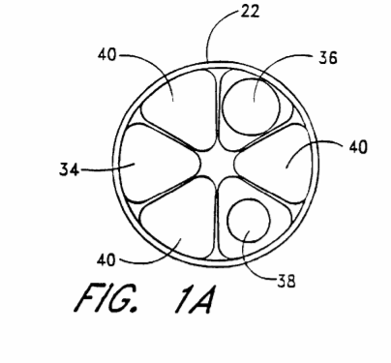
Literature Review - Varying Volumes
18 September 2019
The client wanted a way to vary the amount of Cocoyam dispensed for different dishes
This patent shows how a wheel with sections of varying volumes liquids and powders
By rotating the wheel the volume is quickly changed
Allows for easy use for varying viscosities
Figure 10: Illustrates the use of different shapes and volume to dispense variable amount [10]
Des Vignes 10

Slide 11
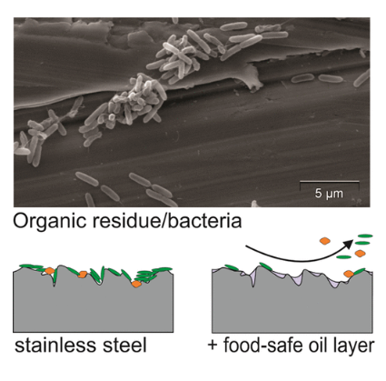
Literature Review - Food Safe
18 September 2019
Food safe oil-based slippery coatings (FOSCs)
Suppress bacterial adherence to stainless steel surfaces
Create biofilm
Improved surface cleanability
Effective even on worn, rougher surface
Food safety is major concern in project
Figure 11: Representation of bacteria trapping in grooves[11]
Morrison 11

Slide 12
Customer Requirements
18 September 2019
Top Four Ranked Requirements:
Reliability
Safe to use
Simple
Faster than current method of hand rolling
Other Requirements:
Durability
Lightweight
Low Cost
Adjustable Dispensing
Mobility
Morrison 12

Slide 13
Engineering Requirements
18 September 2019
Top Four Ranked Requirements
Minimize Number of Parts [#]
Number of Dispenser Settings [#]
Low Price [$]
Minimize Time to Produce One Roll [sec]
Other Requirements
Low Weight [kg]
Base Footprint [m²]
Volume of Materia to Create Device [m³]
Smooth Edges [mm]
Material Strength [N/m²]
Material Density [kg/m³]
Capacity [L]
Morrison 13

Slide 14
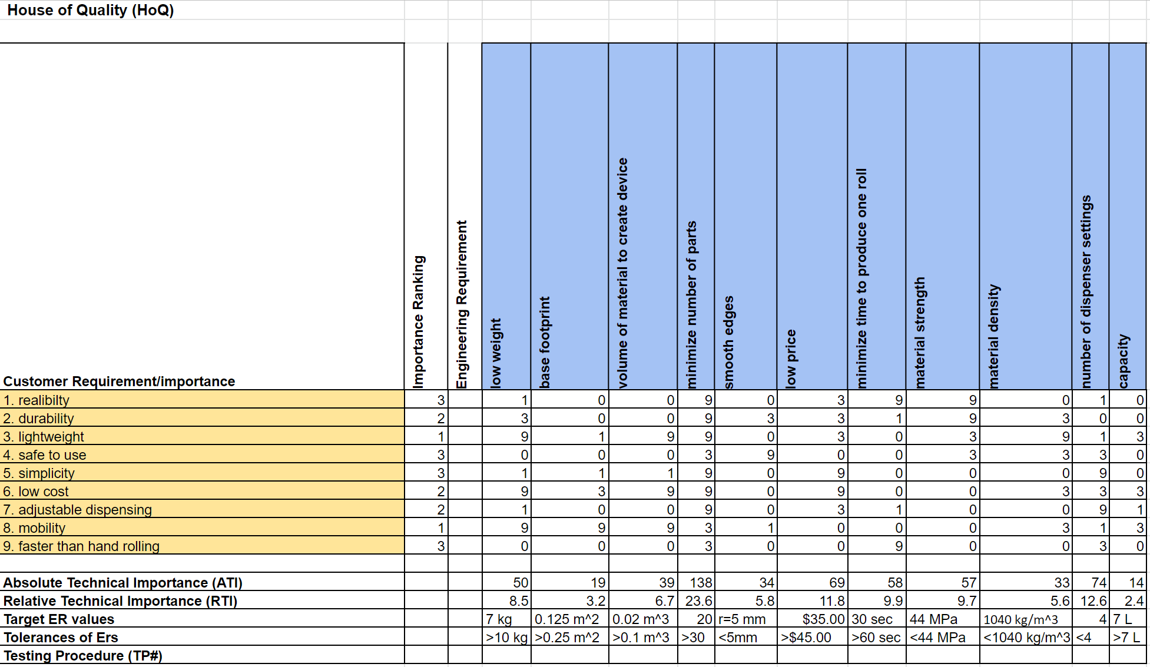
House of Quality
18 September 2019
Figure 12: House of Quality
Morrison 14

Slide 15
Schedule
18 September 2019
A Gantt chart was used to assign tasks a due dates for assignments
Tasks listed are the most critical portions and steps of each assignment
Milestones were used to indicate assignment due dates and critical portions of the project
Team members assigned to each task in the resources tab
Due dates on assignments are set one day prior to align with team charter
Des Vignes 15

Slide 16
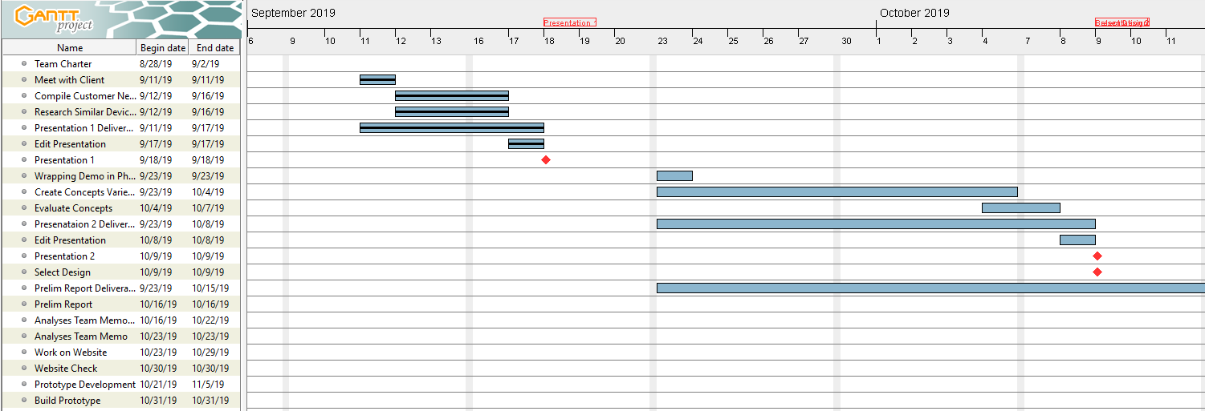
Schedule
18 September 2019
Figure 13: Fall 2019 Gantt Chart
Des Vignes 16

Slide 17
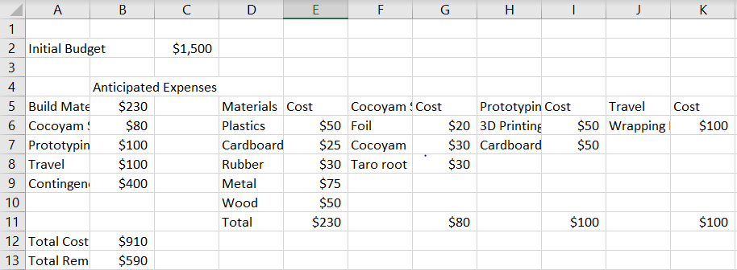
Budget
18 September 2019
This is a very rough estimate for the project
Estimates are set high to allow for flexibility
Largest expenses are Cocoyam substitutes, contingency money, and building materials
A high contingency amount allows for catastrophic failures or changes
Figure 14: Estimated Budget for Rural Food Processor
Des Vignes 17

Slide 18
Future Work
18 September 2019
Meet with contact of client to observe technique
Concept Generation
Concept Evaluation
Initial Design
Des Vignes 18

Slide 19
Questions?
18 September 2019
19

Slide 20
Citations
18 September 2019
[1] Evan Williamson, “Coco-YUM! - The manual cocoyam processor,” YouTube, 23-Jul-2019. [Online]. Available: https://www.youtube.com/watch?v=siXvcSSyxC4#action=share. [Accessed: 15-Sep-2019].
[2]Admin, “Health Benefits and Nutrition of Taro Root,” TAROTO TAIWANESE HEALTHY DESSERT. [Online]. Available: https://tarotodessert.com/en/2017/health-benefits-and-nutrition-of-taro-root/. [Accessed: 17-Sep-2019].
[3] G. Her and G. Roller, "Grape Leaves Roller", Must Have Stuff, 2019. [Online]. Available: https://musthavestuff.com/grape-leaves-roller/. [Accessed: 16- Sep- 2019].
[4]Amazon.com, 2019. [Online]. Available: https://www.amazon.com/Sushi-Making-Kit-Yomo-inches/dp/B00OAXPU5I. [Accessed: 17- Sep- 2019].
[5]"Server 88750 Single Dry Food Dispenser 2 Liter", Ekuep, 2019. [Online]. Available: https://uae.ekuep.com/en/smallwares/serving-supplies/dry-food-dispenser-parts-and-accessories/server-88750-single-dry-food-dispenser-2-liter. [Accessed: 18- Sep- 2019].
[6]"2018 China Supplier Plastic Container Bulk Food Dispenser Mechanism Candy Dispenser For Sale - Buy Candy Dispenser, Bulk Food Dispenser, Plastic Container Product on Alibaba.com", www.alibaba.com, 2019. [Online]. Available: https://www.alibaba.com/product-detail/2018-China-supplier-plastic-container-bulk_60641074197.html?spm=a2700.details.maylikeexp.3.720278ffYS0cN4. [Accessed: 17- Sep- 2019].
[7]C.-C. Kao, "Automatic Egg Roller". United States of America Patent 3633517, 6 August 1970.
[8]“The effects of selective logging on forest structure and ...” [Online]. Available: https://www.sciencedirect.com/science/article/pii/S0378112703001075. [Accessed: 17-Sep-2019].
[9]J.-F. Bastin, N. Barbier, M. Réjou-Méchain, A. Fayolle, S. Gourlet-Fleury, D. Maniatis, T. de Haulleville, F. Baya, H. Beeckman, D. Beina, P. Couteron, G. Chuyong, G. Dauby, J.-L. Doucet, V. Droissart, M. Dufrêne, C. Ewango, J. F. Gillet, C. H. Gonmadje, T. Hart, T. Kavali, D. Kenfack, M. Libalah, Y. Malhi, J.-R. Makana, R. Pélissier, P. Ploton, A. Serckx, B. Sonké, T. Stevart, D. W. Thomas, C. D. Cannière, and J. Bogaert, “Seeing Central African forests through their largest trees,” Nature News, 17-Aug-2015. [Online]. Available: https://www.nature.com/articles/srep13156. [Accessed: 17-Sep-2019].
[10] W. G. Smith, " Method and Apparatus for controllably Dispensing Powders and Liquids". United States of America Patent US 6,550,640 B2 , 22 April 2003.
[11] Awad, T., Asker, D. and Hatton, B. (2018). Food-Safe Modification of Stainless Steel Food-Processing Surfaces to Reduce Bacterial Biofilms. ACS Applied Materials & Interfaces, 10(27), pp.22902-22912.
20

